Slide 1

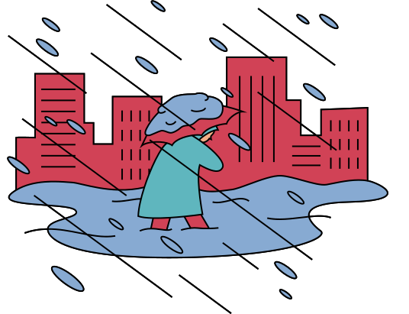
METEOSCOPE
Will It Rain On My Parade?
<By KASTWO/>

Slide 2
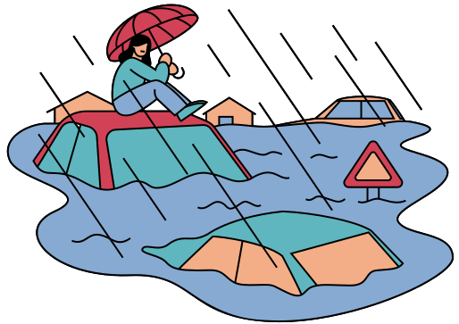
CHALLENGE
Create an application with a custom interface that allows users to perform a custom query to determine the probability of “very hot,” “very cold,” “very windy,” “very humid,” or “very uncomfortable” conditions for the specified location and time.
<By KASTWO/>

Slide 3



METEOSCOPE
An application for accurate analysis of meteorological data.
<By KASTWO/>

Slide 4



Features
1. Fast and accurate forecasts
2. Search by city and date
3. Smart proposal
Forecasts available for today and 2 weeks
Interactive map with real-time location
Offers activities conducive to weather conditions
<By KASTWO/>

Slide 5



Target
Logistics and agricultural companies
Travelers, hikers, outdoor enthusiasts
Users seeking accurate and fast local forecasts
<By KASTWO/>

Slide 6
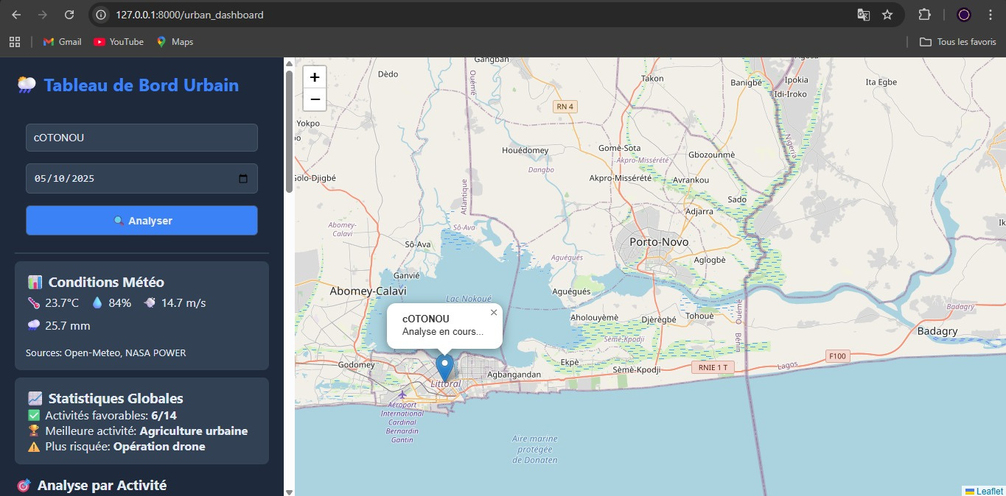
VISUALIZATION
<By KASTWO/>

Slide 7

METEOSCOPE
Don't let the weather decide for you anymore
< THANK YOU FOR YOUR ATTENTION/>
<By KASTWO/>

